Slide 1
" Robotics & Automation Workshop - 2025
– Igniting Innovation in Young Minds"
Presented by: Nepal Tech Robotics Team
Trainer = Pujan Bhusal
New Horizon College , Drivertole ,Rupandehi

Slide 2
Introduction to Electronics Circuits
Notes:
‹#›
1. Add photos of the circuits
2. Show more clearly how energy flows through breadboard
3. Explain connectivity and wires
4. Show the wiring of the breadboards
5. Parts, and wires need to share the same row
6. Explain the LED before wiring, do an LED to battery. Maybe, burn it out to show the problem of no resistor.
7. Explanation of polarity in regards to troubleshooting and debugging.
8. Show in diagrams the part in holes more clearly.

Slide 3
What is electricity?
What kinds are there?
What can it do?
What are the dangers?
Notes:
Flow of electron due to emf

Slide 4
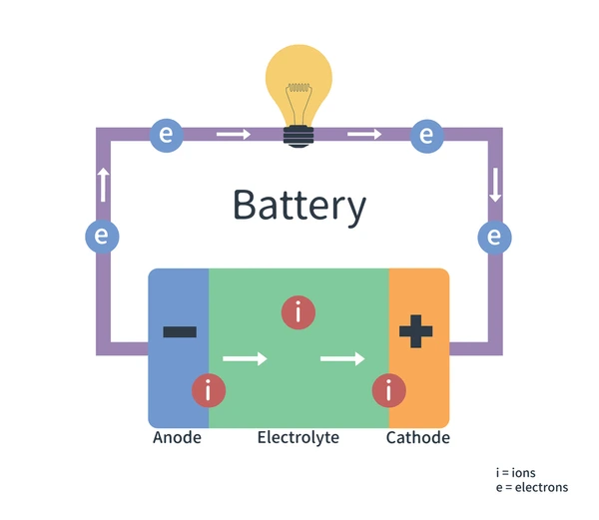
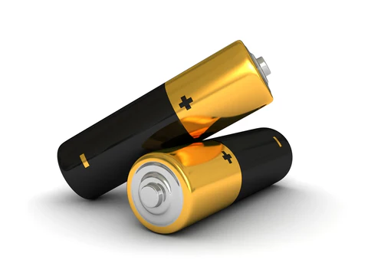
Batteries as a power source
Notes:
How does battery work: dissipation of electrons and movement of ions through wire
Anode is negative which is made of graphite and cathode is positive made of lithium metal oxide

Slide 5
What is a circuit?
Combination of electronic parts, wires connected between power sources. It's like a physical program. It's also like setting up dominoes in sequence.
Notes:
‹#›
Show example of LED circuit with only wires.

Slide 6
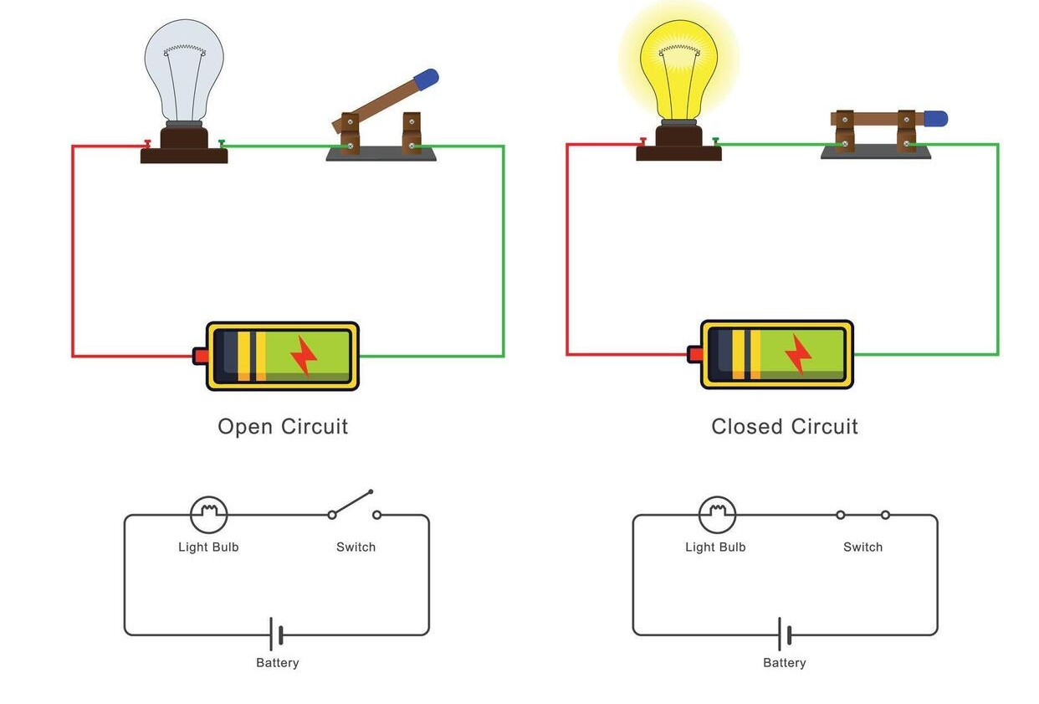
Types of Circuits

Slide 7
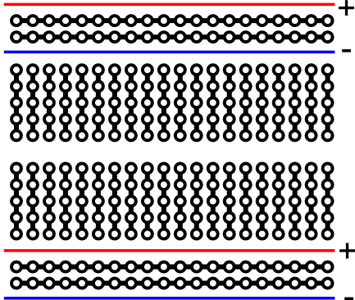
What is a breadboard?
What are they good for?
Creatings, organizing, and prototyping a circuit.
Literally started out as a bread board with nails.
Notes:
‹#›
Find a interactive example. Also, show an old fashioned breadboard example.

Slide 8
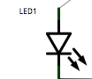
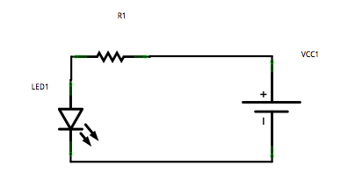
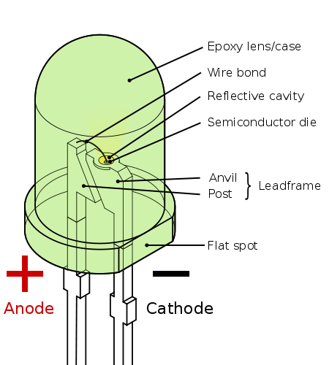
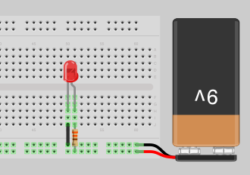
What are LEDs?
Light Emitting Diodes
Diode Symbol + Arrows for light
Points to ground
Notes:
‹#›
Explain Anode, and Cathode. Create a circuit using breadboard and LED.

Slide 9
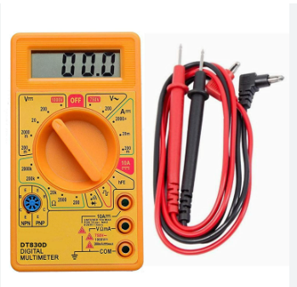
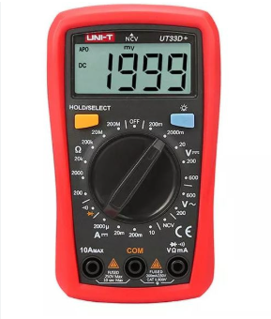
Multimeter

Slide 10
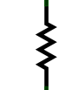
What are resistors?
Resistors limits the amount of current in the circuit or wire. Ohm's law is used to calculate the properties related to resistance.
Ohm's Law: I = V/R
I = Current measured in Amps
V = Voltage measured in Volts
R = Resistance measured in Ohms
Resistors are color coded.

Slide 11
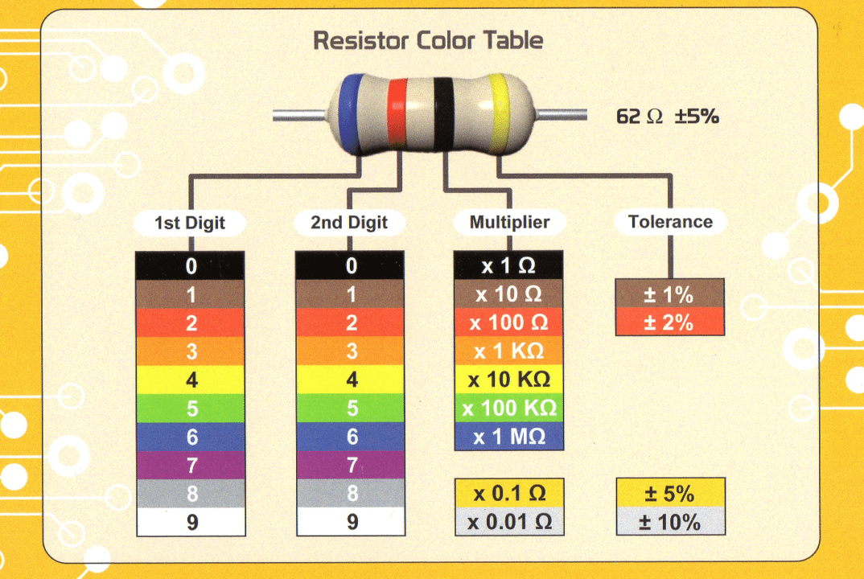
Resistor Color Code

Slide 12
Hello World for a Circuit
Light and LED
Parts:
Battery
Resistor
LED
Why:
Power Source
An LED will light up when enough voltage is supplied but can also burn out if too much is allowed to pass through. The resistor will limit the voltage to prevent damage.
Do:
Connect Battery, Resistor, LED

Slide 13
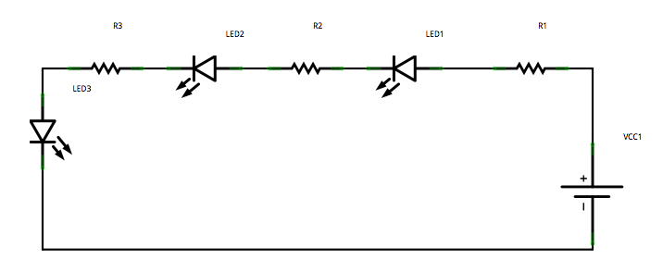
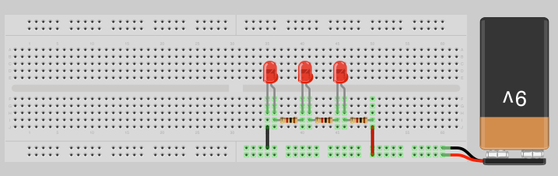
Series circuit example

Slide 14
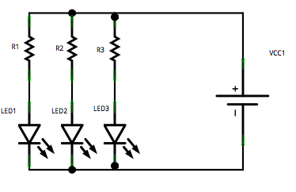
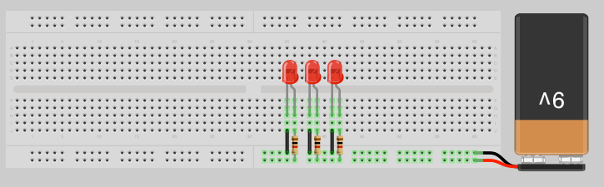
Parallel Circuit example

Slide 15
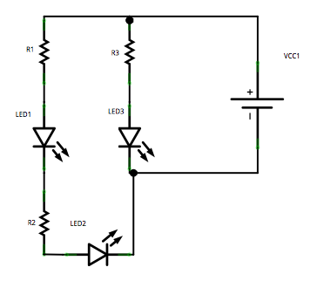
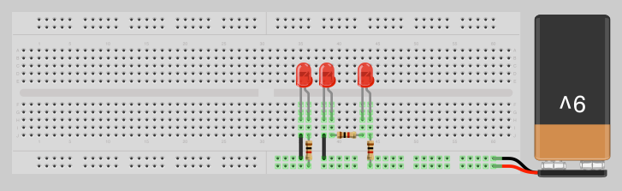
Parallel and Series Circuit Example
Notes:
‹#›
Find a good explanation or modify the circuit to be more visual.

Slide 16
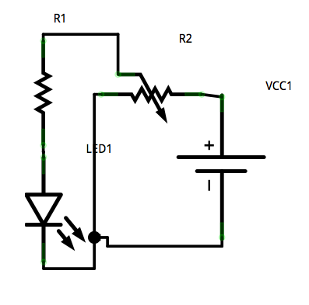
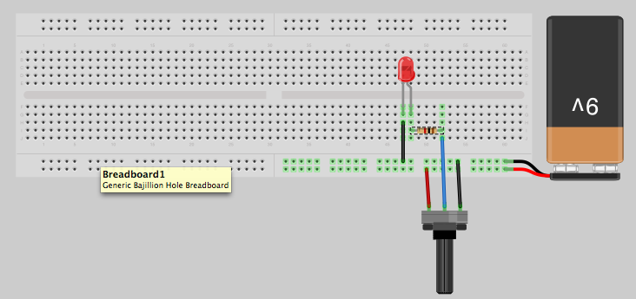
Variable resistor: The potentiometer
Voltage dividers
Try out the different pots.

Slide 17
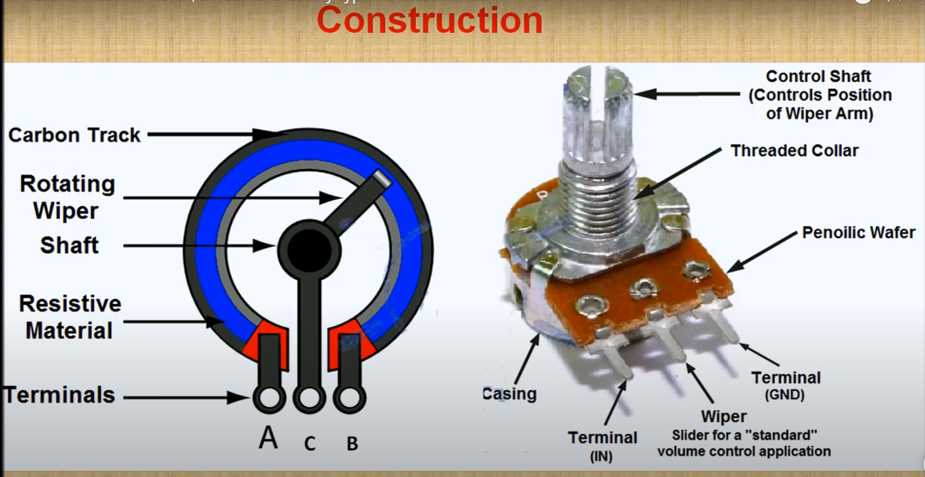
Variable resistor: The potentiometer
Voltage dividers
Try out the different pots.

Slide 18
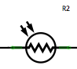
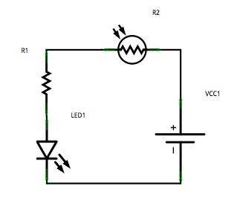
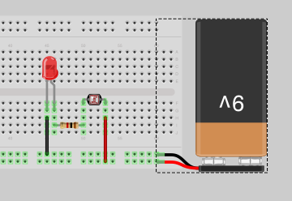
LED and Photoresistor
Photoresistors change their resistance by the amount of light detected.

Slide 19
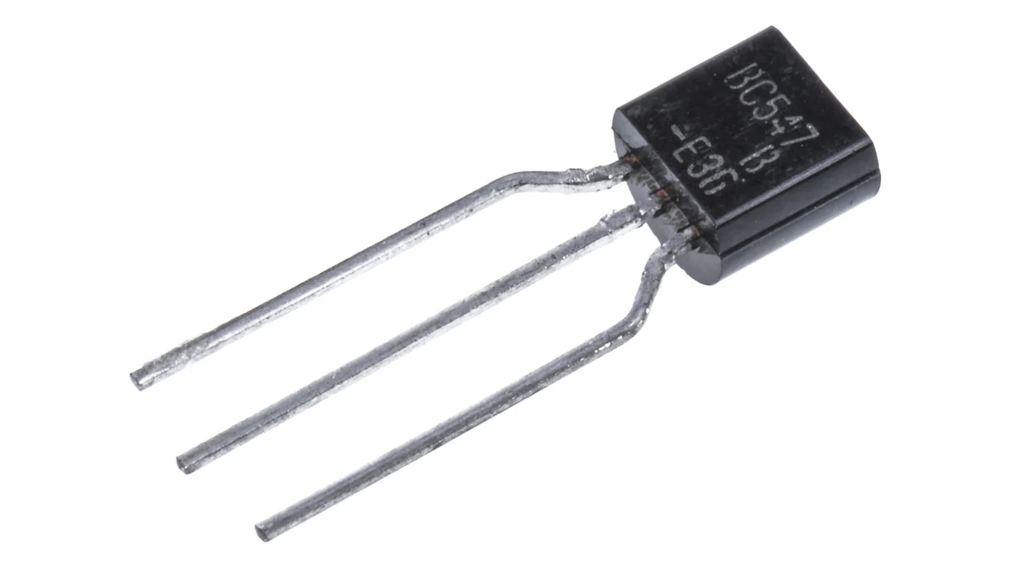
Transistors
A transistor is a small electronic device that can turn electricity on and off or amplify signals.

Slide 20
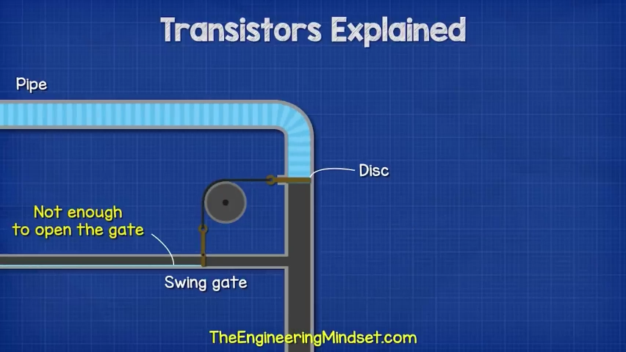

Slide 21
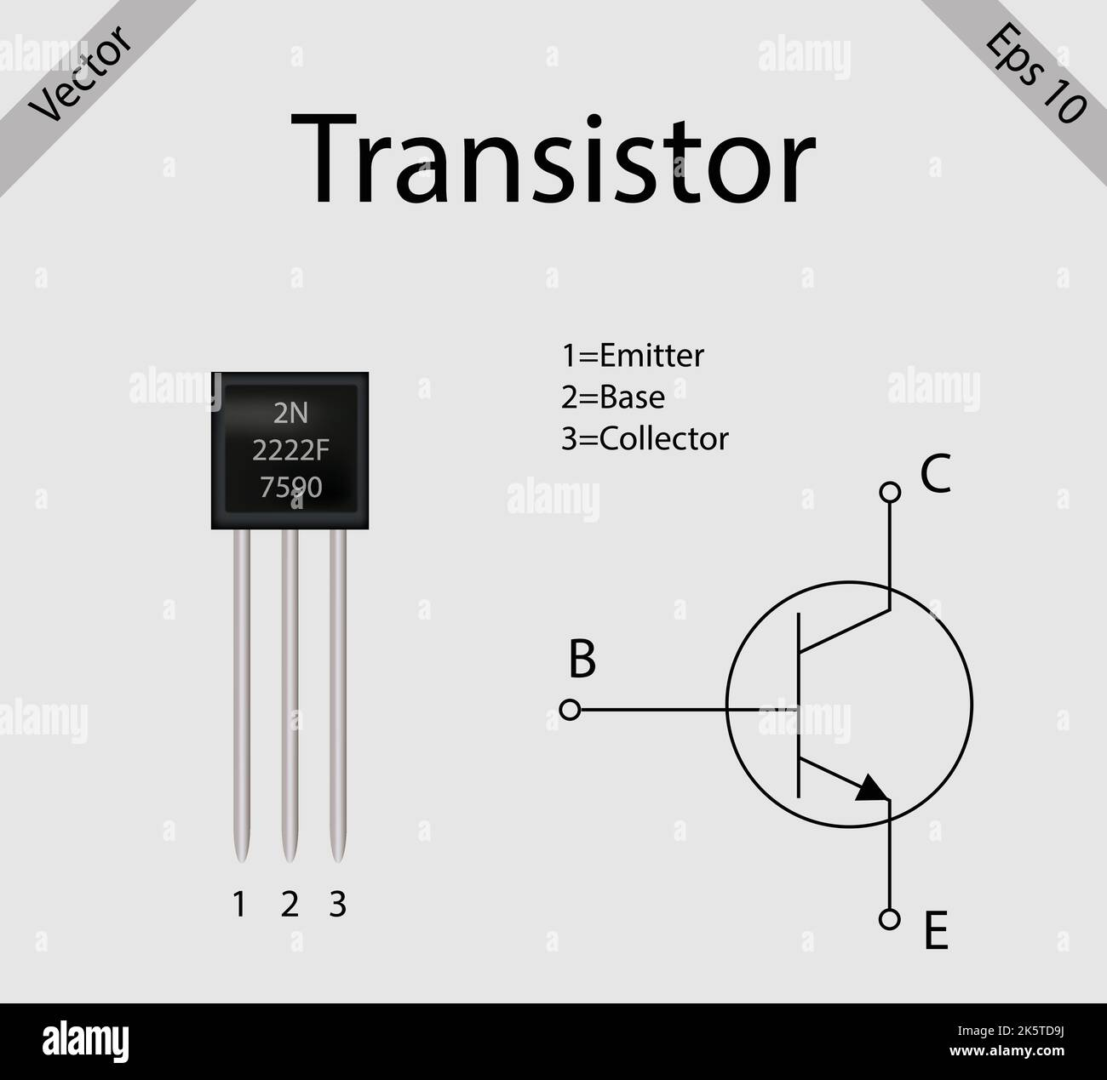

Slide 22
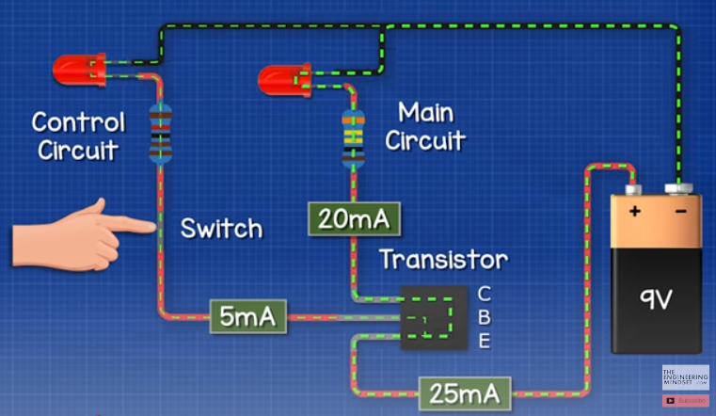
Circuits using Transistor

Slide 23
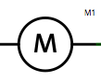
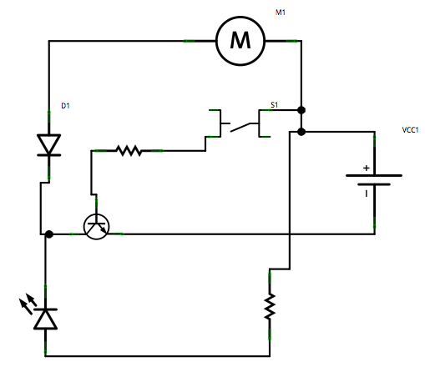
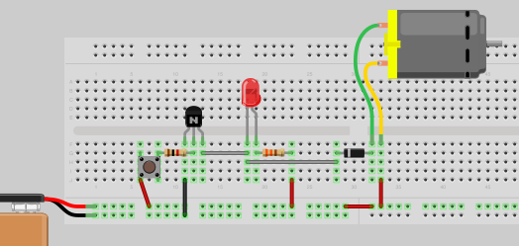
Motors
Try changing the direction
of the diode.
What happens?

Slide 24
Introduction to Robots Part 1

Slide 25
What is Robot?

Slide 26
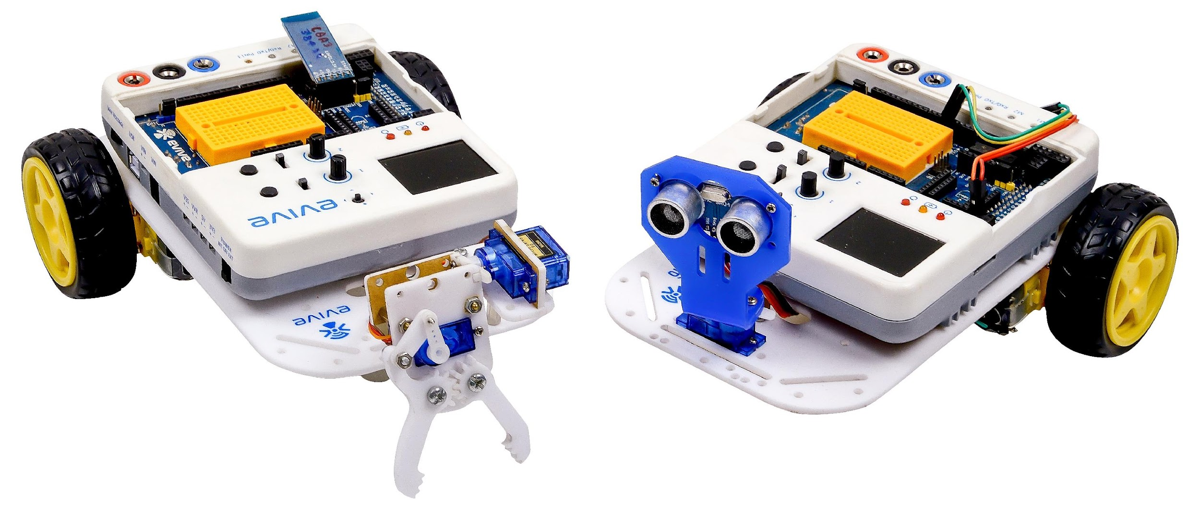
What is Robot?
Powered by Electricity.
Programmed to carry out certain tasks, like cleaning, etc.
Senses the environment using sensors and reacts accordingly on its own.

Slide 27
Classification of Robots
A robot can be controlled by humans, either directly, or remotely, from a place far away.
A robot can take decisions and work entirely on its own; such robots are called ‘autonomous robots’.
here also exist robots that can move from one place to another; they are known as ‘mobile robots’.
There are robots, autonomous robots, mobile robots, and then, there are autonomous mobile robots like obstacle avoiding robots.

Slide 28
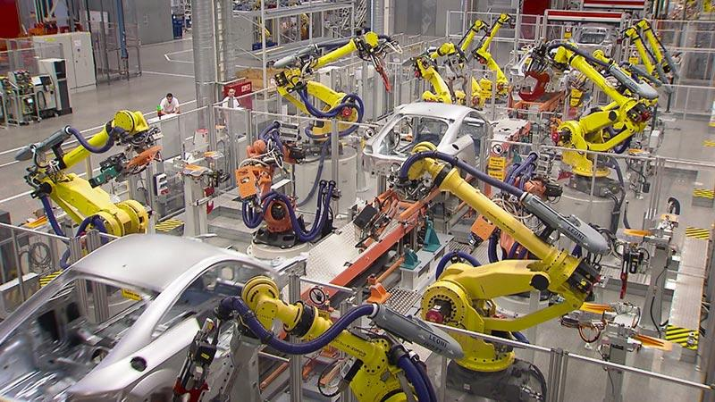
Application of Robots
Industry: For handling and moving materials.

Slide 29

Application of Robots
Space: For exploring outer space. E.g., the Curiosity Rover

Slide 30
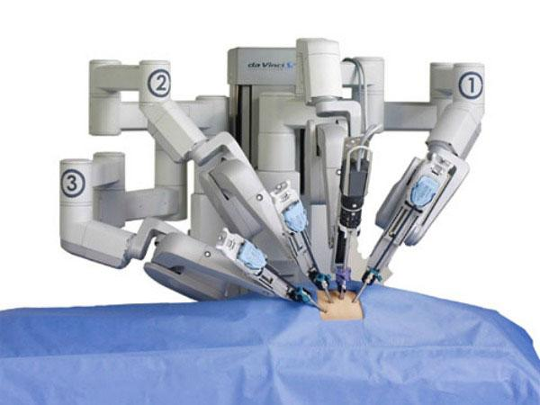
Application of Robots
Hospital: Surgical robots, réhabilitation robots, pharmacy robots, etc.

Slide 31
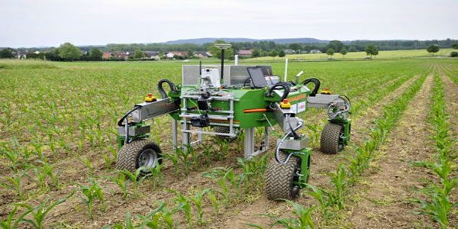
Application of Robots
Agriculture: For tasks such as vegetable and fruit picking.

Slide 32
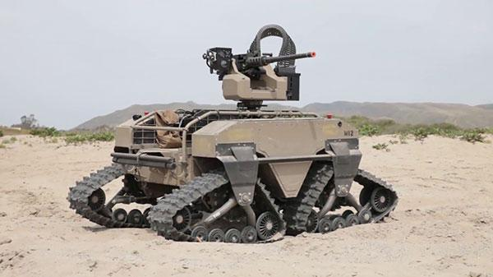
Application of Robots
Military: Bomb discarding robots, drone explorations, etc.

Slide 33
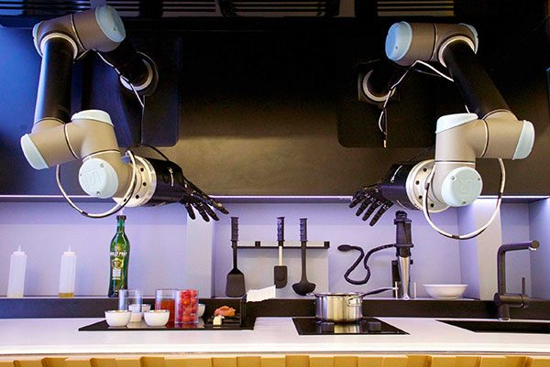
Application of Robots
Households: For cooking, cleaning, and washing purposes.

Slide 34
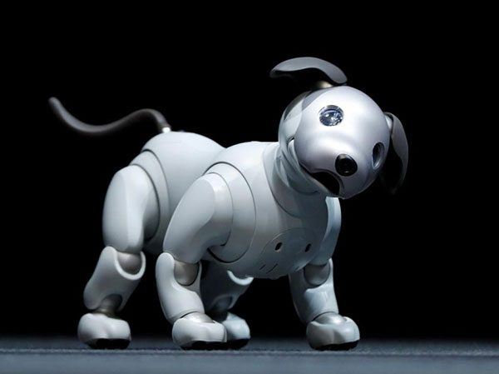
Application of Robots
Entertainment: Humanoids, robot dogs, etc. E.g. Aibo the robot dog.

Slide 35
Basic Components of Robot - Hands

Slide 36
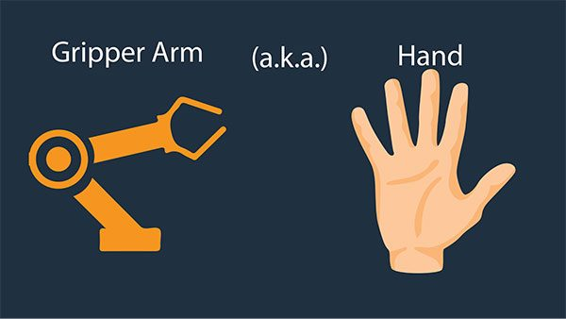
THE ‘HANDS’

Slide 37
THE ‘HANDS’
Robot hands are known as end-effectors.
There different types of end effectors for different purposes.
The most common type is a gripper. A gripper allows the robot to hold objects, carry them, and then release them.
Grippers come in many sizes and styles so that the correct ones can be used according to the work to be done.

Slide 38
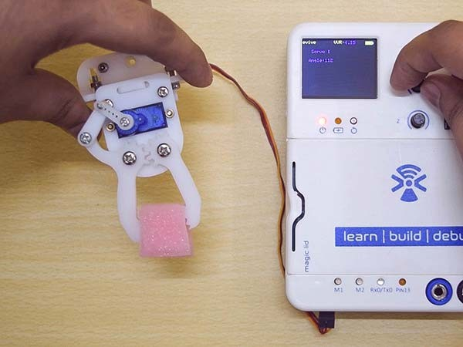
THE ‘HANDS’

Slide 39
Basic Components of Robot - Feet

Slide 40
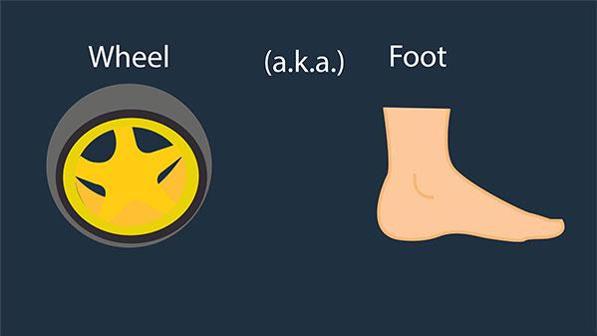
THE ‘FEET’

Slide 41
THE ‘FEET’
Robots need something that will help in moving around.
Mobile robots move with the help of wheels (generally, but not necessarily).
These wheels are attached to the DC motors (actuators) that turn them, thus helping the robot go places.

Slide 42
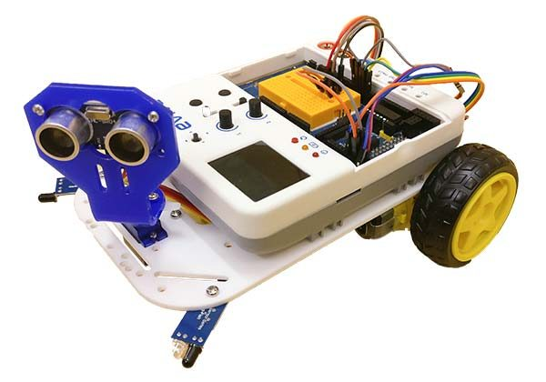
THE ‘FEET’

Slide 43
THE ‘FEET’
For a moving object to be stable, you need at least 3 contact points with the surface on which it is moving.
For e.g. in a car, you have four wheels, but in a bicycle, there are only two wheels.
A cyclist can control the bicycle only when he is cycling, but if he stops he can’t balance the cycle without resting one of his feet on the ground.
In our mobile robot, we will have 2 wheels and one caster wheel touching the ground. A caster wheel has a small round sphere, which rolls freely on the ground. It is passive and can move in any direction.

Slide 44
Basic Components of Robot - Muscles

Slide 45
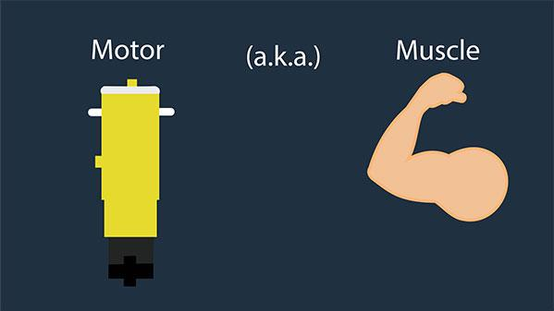
THE ‘MUSCLES’

Slide 46
THE ‘MUSCLES’
A robot also has muscles. They are known as actuators.
The actuator helps the brain of the robot to respond to the surrounding environment.
It helps the robot to move its hands (grippers), and its feet (wheels and the castor).
The robots that you will be making consist of DC (direct current) motors and servo motors as electrical actuators.

Slide 47
Introduction to Robots Part 2

Slide 48
What is Robot?
Powered by Electricity.
Programmed to carry out certain tasks, like cleaning, etc.
Senses the environment using sensors and reacts accordingly on its own.

Slide 49
Basic Components of Robot - Skeleton

Slide 50
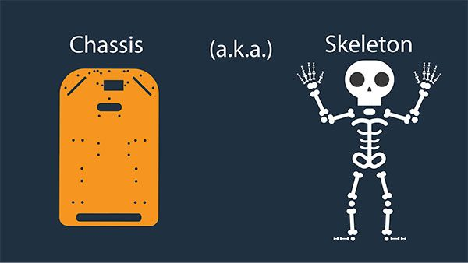
THE ‘SKELETON’

Slide 51
THE ‘SKELETON’
What is a body without a skeleton? Nothing but a soft sac, without the rigidity, and the shape that defines it.
Here, the only difference between the robot and us is that it is not exactly a spongy sac; it is a hard sac, with a lot of dismantled parts.
Our skeleton has bones, a robot’s skeleton is a robot chassis or simply a chassis – it is a frame (in our case a base plate) onto which everything - the actuators, the effectors, the wheels, the castor, the grippers, the brain - is attached and supported.

Slide 52
Basic Components of Robot - Sensors

Slide 53
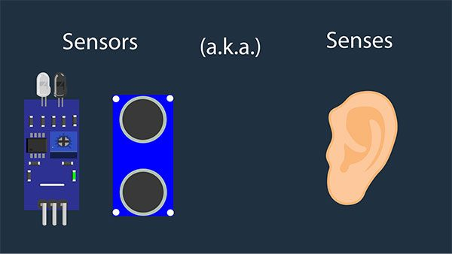
THE ‘SENSES’

Slide 54
THE ‘SENSES’
A sensor is a device that detects input from the outside world and responds to it.
Just like we have many different types of senses and different ‘sensors’ for them, such as eyes for seeing, ears for hearing, nose for smelling, tongue for tasting, and skin for touching, robots are also capable of sensing different things such as light, sound, and temperature, and have many different sensors for them.

Slide 55
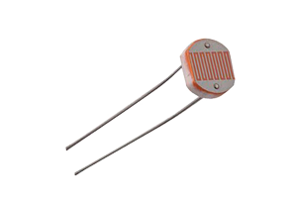
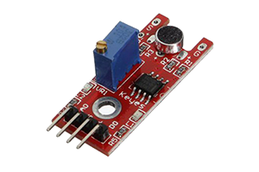
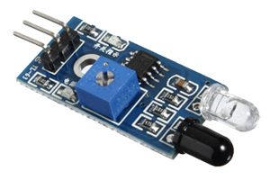
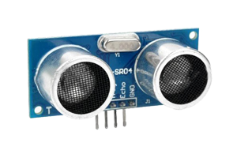
THE ‘SENSES’
Light Sensors
Sound Sensors
Proximity Sensors
Distance Sensors

Slide 56
Basic Components of Robot - Brain

Slide 57
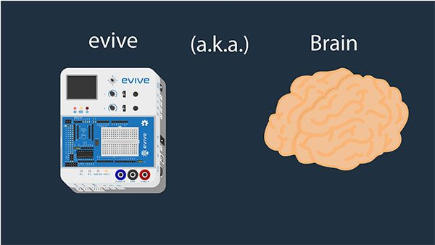

THE ‘BRAIN’ = Arduino

Slide 58
THE ‘BRAIN’ = Arduino
The robot has detected all that is happening around it. Now, it has to respond to it. But it needs to make sure that it does to correctly. Who or what is going to tell him what to do, and how to respond in the right way?
The brain is responsible for controlling all the senses, and, functions of the body, such as thinking (I think, therefore I am), eating, sleeping, and moving the arms and the legs.
The robot’s brain also does the same. It controls what it thinks, what it does, and how it moves its arms and legs.

Slide 59
Basic Components of Robot - Commands

Slide 60


THE ‘BRAIN’ = Arduino

Slide 61
THE ‘BRAIN’ = Arduino
At this moment, our robot’s got everything; right from the brain down to the feet. But since it is not exactly a human, it still doesn’t know as of yet what to do and how to do it.
You will give commands to the robot and ask it to do what you want him to, and he has to follow them!
These commands that we are talking about are nothing but the instructions that are given by writing a program for the specified task.

Slide 62
Different Types of Robots

Slide 63


Smartphone Controlled Robot
This robot will follow your commands via Bluetooth and go where you want him to go.

Slide 64

Follow Me Robot
This robot will follow you, or anybody else that comes in front of it.

Slide 65
Obstacle Avoiding Robot
This robot avoids obstacle and move autonomously.

Slide 66

Pick and Place Robot
This robot will pick objects for you and place them where you want.

Slide 67

Stair Climbing Robot
This robot can work in uneven ground terrains like stairs and rock.

Slide 68

Gesture Controlled Robot
This robot moves according the gesture you make on your smartphone, like moving forward when you tilt it forward.

Slide 69


Line Following Robot
This robot works autonomously. It has only one work, follow the black line.

Slide 70

Dust Cleaning Robot
This robot has a DIY vacuum cleaner attached to it. This is controlled using smartphone and can clean your room.

Slide 72
INTRODUCTION TO ARDUINO

Slide 73
ARDUINO
Arduino is the go-to gear for artists, hobbyists, students, and anyone with a gadgetry dream.
Arduino rose out of another formidable challenge: how to teach students to create electronics, fast.
With Arduino, you can control almost everything around you be it simple LED or giant Robots.

Slide 74
ARDUINO
Basically Arduino is Microcontroller.
Microcontroller is microprocessor with memory, RAM and some other peripheral connected with it.
The Arduino Uno is a microcontroller board based on the ATmega328 . The ATmega328 has Flash memory of 32 KB (with 0.5 KB used for the bootloader). It also has 2 KB of SRAM and 1 KB of EEPROM
Notes:
Flash- Where program is stored.
SRAM-Static Random Access Memory ( sketch creates and manipulates variables when it runs )
EEPROM- Electrically Erasable Programmable Read-Only Memory ( memory whose values are kept when the board is turned off )

Slide 75





DIFFERENT TYPES OF ARDUINO
Boarduino Kit
Arduino LilyPad
DIY Arduino
Arduino Uno
Arduino Mega 2560

Slide 76
ARDUINO UNO
What does it have?
14 Digital In/Out pins (6 can be used as PWM)
6 Analog Inputs
A USB Connection
A Power Jack
Reset Button
On-board LED
SCL/SDA pins (Serial Clock/ Serial Data pins)
In short, it contains everything needed to support the microcontroller; simply connect it to a computer with a USB cable or power it with a AC-to-DC adapter or battery to get started.

Slide 77

USB
(to Computer)
PWR IN
RESET
SCL\SDA
(I2C Bus)
POWER
5V / 3.3V / GND
Digital I\O
PWM(3, 5, 6, 9, 10, 11)
Analog INPUTS

Slide 78

HOW TO CODE IN ARDUINO
You need to download Arduino IDE (Integrated Development Environment).
Arduino IDE is available for all Mac, Windows.and Linux.

Slide 79

HOW TO CODE IN ARDUINO
Once you have downloaded and installed/extracted the folder, you can directly run Arduino.exe, which will take you to its IDE.
The IDE will look like the shown screenshot.
error & status messages

Slide 80

PROGRAM YOUR ARDUINO
Before you start programming, double check that correct board is selected under Tools 🡪 Board.
Now, you can start playing with Arduino.

Slide 81

PROGRAM YOUR ARDUINO
The Arduino Uno can be programmed with the Arduino software. Select "Arduino Uno from the Tools > Board menu (according to the microcontroller on your board).
All the peripheral connected with Computers are using Serial Port.
You can check port for Arduino Uno in Device Manger.

Slide 82

INPUT VS OUTPUT
Image from Theory and Practice of Tangible User Interfaces at UC Berkley

Slide 83
6 MAJOR CONCEPTS
digitalWrite()
analogWrite()
digitalRead()
If (statements) / Boolean
analogRead
Serial Communication

Slide 84

ANALOG VS DIGITAL
Microcontrollers are digital devices – ON or OFF. Also called – discrete.
Analog signals are anything that can be a full range of values.
5 V
5 V
0 V
0 V

Slide 85
ANALOG VS DIGITAL
Analog Sensors
Digital Sensors
Digital sensors are more straight forward than Analog.
No matter what the sensor there are only two settings: On and Off
Example, Push button, Switch
Sensors | Variables
Mic | soundVolume
Photoresistor | lightLevel
Potentiometer | dialPosition
Temp Sensor | temperature
Flex Sensor | bend
Accelerometer | tilt/acceleration

Slide 86
SERIAL COMMUNICATION
“Serial” because data is broken into bits, each sent one after another in a single wire.
Compiling turns your program into binary data (ones and zeros)
Uploading sends the bits through USB cable to the Arduino
The two LEDs near the USB connector blink when data is transmitted.
RX blinks when the Arduino is receiving data.
TX blinks when the Arduino is transmitting data

Slide 87
LET’S START CODING

Slide 88
PROJECT #1 LED BLINK
digitalWrite()

Slide 89


Upload
Compile
Status Message

